Slide 1
CS 4530 Fundamentals of Software Engineering
Module 18: Engineering Equitable Software
Jonathan Bell, Adeel Bhutta, Mitch Wand
Khoury College of Computer Sciences
With contributions by Saiph Savage
© 2022, released under CC BY-SA

Slide 2
Learning Objectives for this Lesson
By the end of this lesson, you should be able to…
List some ways in which software can cause inadvertent harm or amplify inequities, with examples
Explain some techniques that a software engineer can use to detect and mitigate these harms.

Slide 3
From SE @ Google:
As new as the field of software engineering is, we’re newer still at understanding the impact it has on underrepresented people and diverse societies. … [We must recognize] the increasing imbalance of power between those who make development decisions that impact the world and those who simply must accept and live with those decisions that sometimes disadvantage already marginalized communities globally.
Notes:
This is a particularly important topic for a class on software engineering, as there is an enormous imbalance of power between those of us who make software development decisions, building software that’s used broadly, and the rest of the world that simply must accept and live with those decisions. As software engineers, you will likely wield more power than you realize.

Slide 4
Badly-engineered software can kill people
Therac-25 (1985-1987)
Bug in software caused 100x greater exposure to radiation than intended
At least 6 died
Likely far more suffered: deaths occurred over a period of 2 years!
Weak accountability in manufacturer’s organization
“Therac-25” by Catalina Márquez, Wikimedia commons, CC BY-SA 4.0
https://ethicsunwrapped.utexas.edu/case-study/therac-25
Notes:
In contrast to the Citigroup tower case, where the engineering firm took responsibility for the failure and rectified it, let’s consider another classic professional ethics case, this one, from software engineering. A bug in the software controlling the THERAC-25 radiation treatment machine resulted in the death of at least 6 patients, and administered countless additional overdoses. Investigations after-the-fact found that the manufacturer had extremely poor software development and quality assurance processes, without independent code review, without testing, and without safety checks. The machine operators were assured that overdoses were impossible - software was reused from older machines which had hardware interlocks to prevent these software defects from being catastrophic. Note that one result of this incident is stronger standards for safety-critical (in particular: medical) software, which now require rigorous quality assurance practices. The manufacturer of the machine, however, could have easily prevented further damage had they immediately detected and resolved the bug after the first reported incident in 1985.

Slide 5
Algorithmic sentencing systems can discriminate against Black defendants
Example: the COMPAS Sentencing Tool
 | ALL DEFENDANTS | WHITE DEFENDANTS | BLACK DEFENDANTS
Labeled Higher Risk, But Didn’t Re-Offend | 32.4% | 23.5% | 44.9%
Labeled Lower Risk, Yet Did Re-Offend | 37.4% | 47.7% | 28.0%
Analysis of Broward County, FL data: “How We Analyzed the COMPAS Recidivism Algorithm” by Jeff Larson, Surya Mattu, Lauren Kirchner and Julia Angwin
Notes:
For example: some states use software to assess a criminal defendant’s likelihood of recidivism - a term used to describe criminals who are likely to re-offend. This prediction is used in pre-trial bail hearings, and also in sentencing, where the goal is to assign longer sentences to those most likely to commit another crime. It is likely not unreasonable to be concerned that some judges might be biased against certain defendants, and assign harsher sentences based on those biases. If computers can accurately predict which defendants are likely to commit new crimes, we could potentially reduce bias in our criminal justice system.
Here are the results of an evaluation of one model, the COMPAS Sentencing Tool in Broward County, Florida.
The percentage of false positives and false negatives was roughly 30% in both ways (not great, in any case!)
But if you break down this data by race, you see that black defendants are far more likely to be falsely labeled as high risk than are white defendants. (And vice versa: white defendants are far more likely to be falsely labeled as low risk)
When building such tools, it’s vital to evaluate them on multiple dimensions to ensure that we are not simply re-enforcing existing biases.

Slide 6
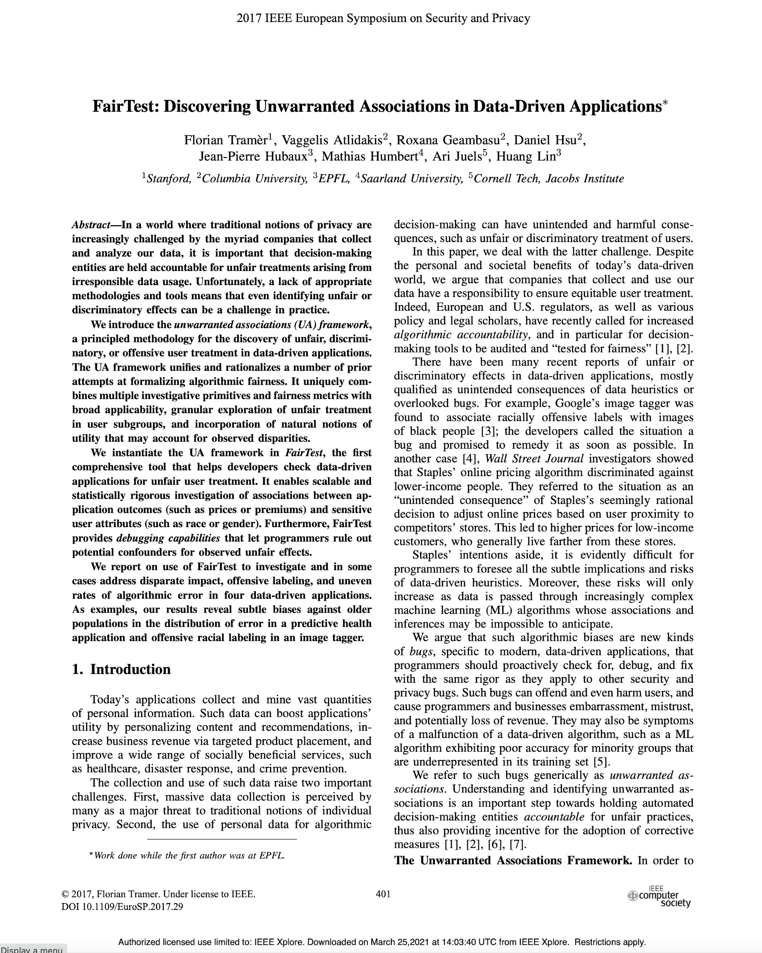
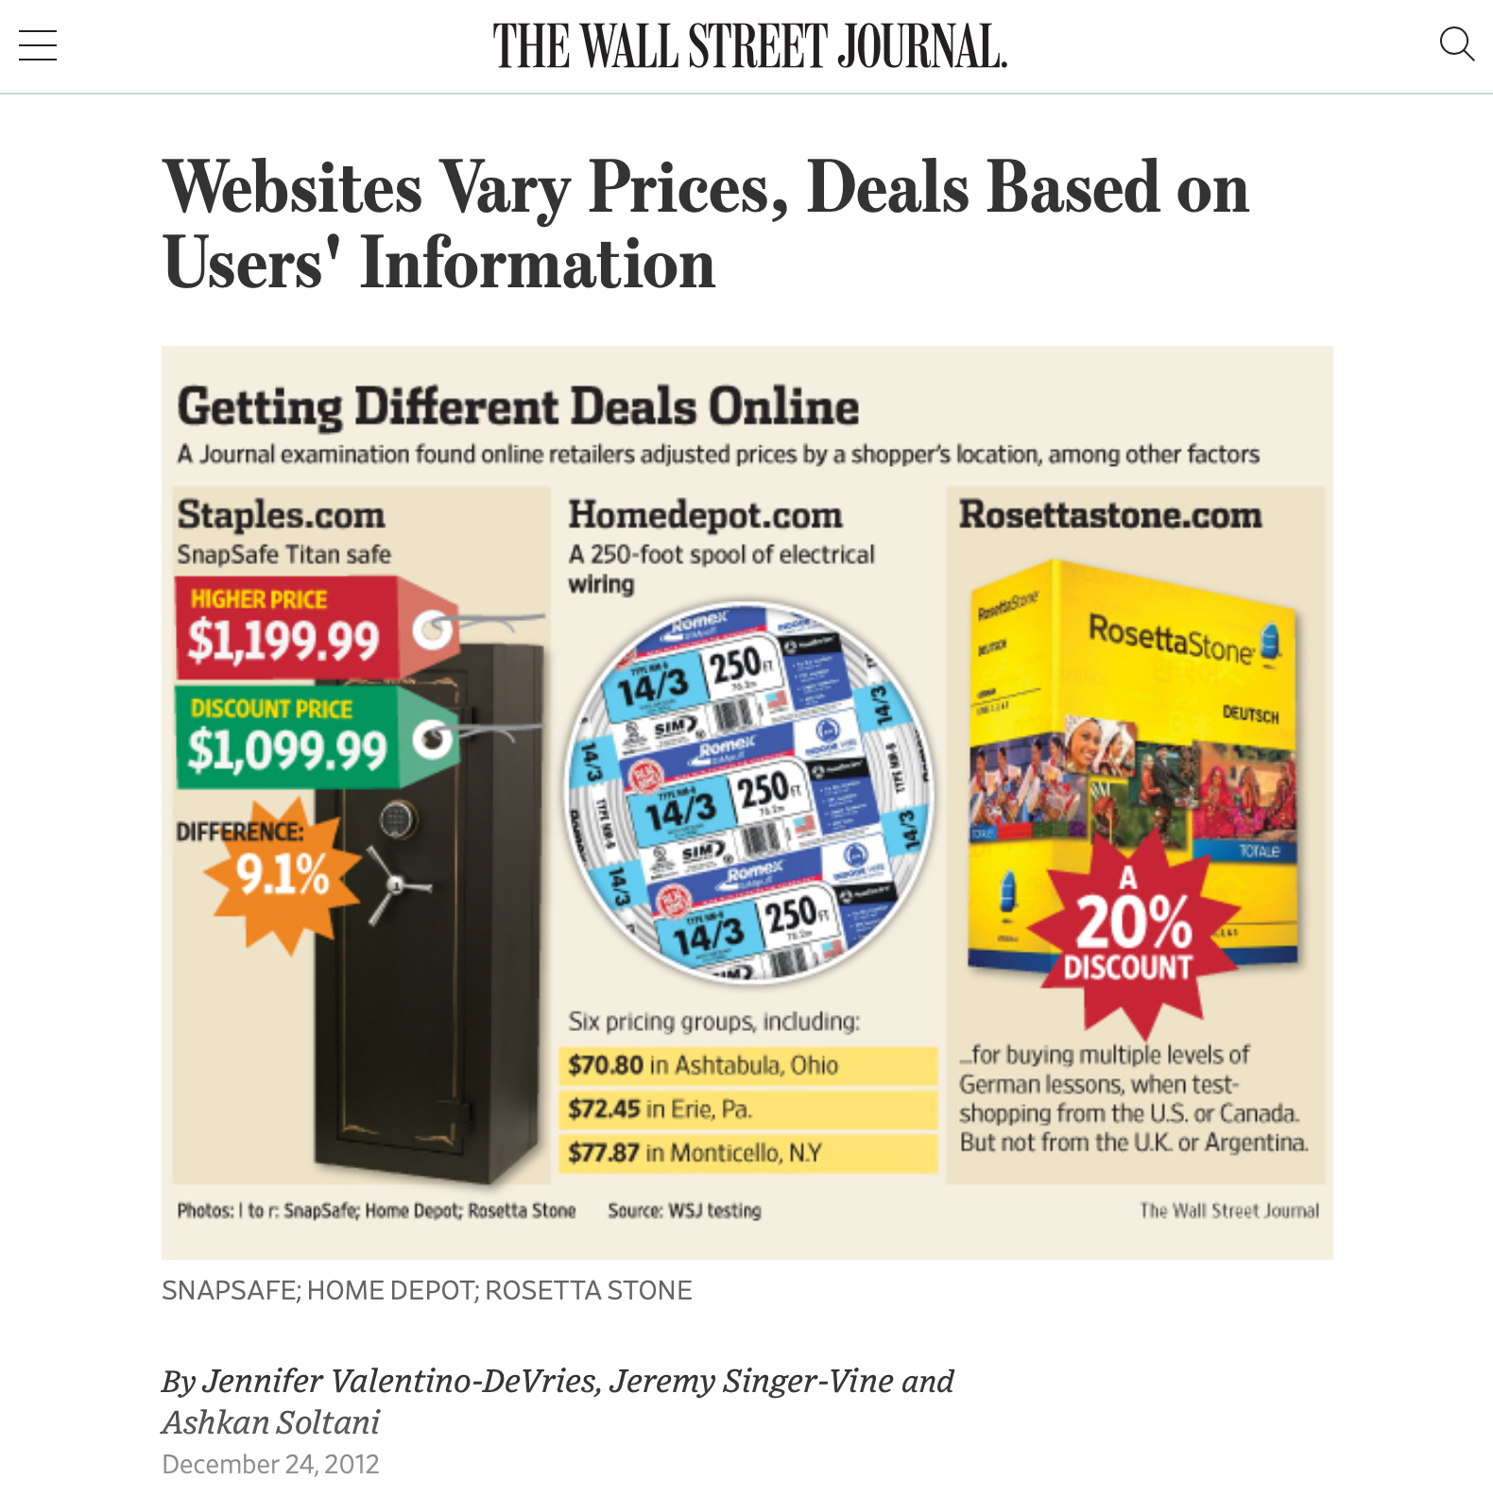
Algorithmic bias can discriminate against poorer consumers
https://www.wsj.com/articles/SB10001424127887323777204578189391813881534
Notes:
Algorithmic bias is all too easy to introduce - it is often easy to overlook hidden correlations between inputs that we feed into our algorithms and real world attributes. For instance: price discrimination and price steering are techniques that dynamically show a different price for the same good or service to different users. For example: Staples, OfficeMax and OfficeDepot compete to sell the same products to the same customers. If I’m Staples, and I’m trying to draw customers who might otherwise go to one of my competitors, I might say something like… “If you live within 20 miles of OfficeMax or OfficeDepot, you will see a cheaper price, otherwise you’ll see more.” This could let me drive revenues: customers who would have gone to a competitor see my low prices, customers who don’t have an alternative will pay the slightly higher price anyway.
On the surface, this sounds fine. But: what if OfficeMax + OfficeDepot are primarily located in wealthy areas? If so, then our policy is actually saying: on the whole, charge wealthy customers less than poor customers. Whether this is an OK policy or not is a topic for a class on business ethics - what our interest as software engineers is is simply in recognizing that this could be an unintended harm.

Slide 7
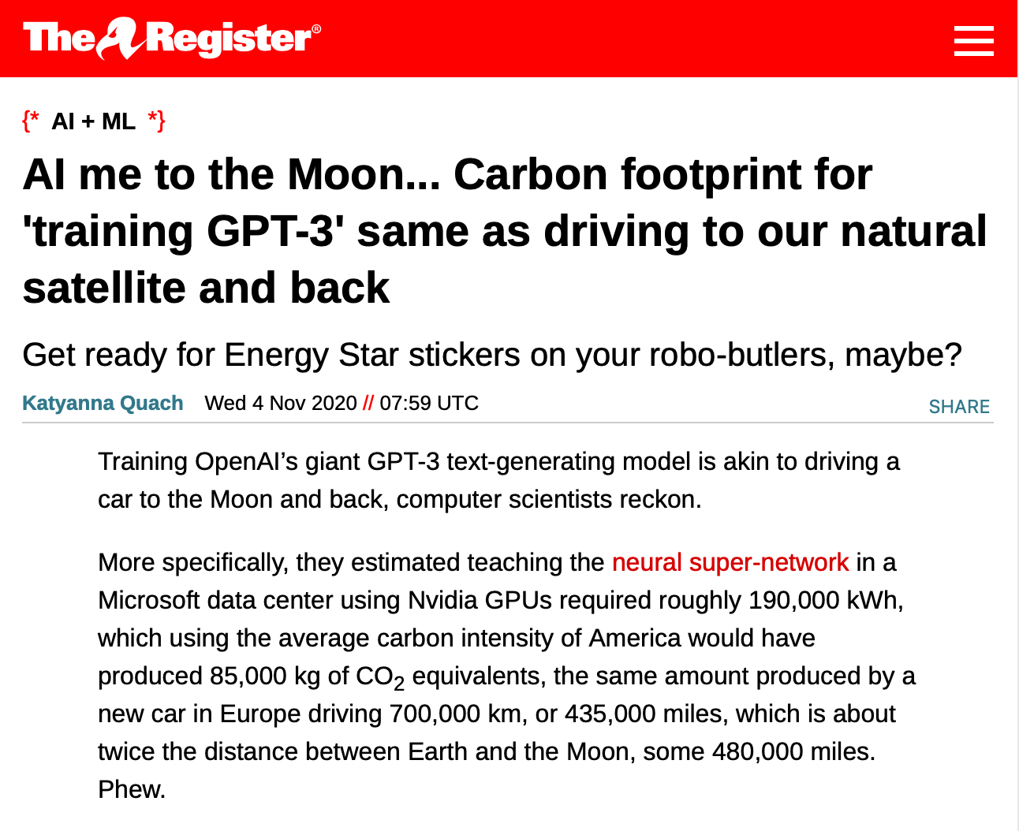
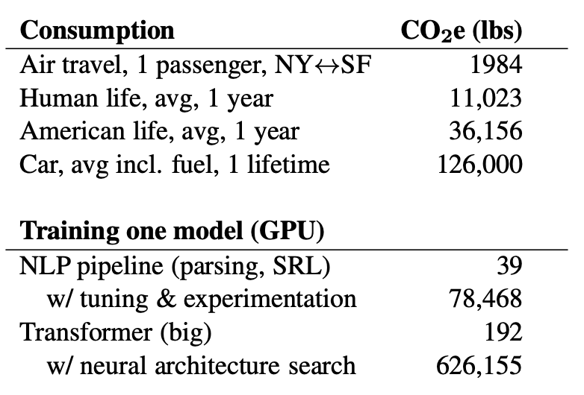
AI training systems can have serious impacts on climate.
Not to mention bitcoin mining!
“Energy and Policy Considerations for Deep Learning in NLP” Emma Strubell, Ananya Ganesh, Andrew McCallum, in Proceedings of ACL 2019
https://www.theregister.com/2020/11/04/gpt3_carbon_footprint_estimate/
Notes:
As we build more and more complex software and in particular, machine learning models, it is also becoming increasingly important to quantify the climate impact of our software. For example, consider training GPT-3, which is the huge text-generation model that lets gmail/google docs auto-complete your sentences and write entire documents for you. The power consumption of the training process was equivalent to driving a car for 435,000 miles. Other studies have pointed out that in training and developing models, there’s often an even greater carbon impact. Again, this is not to say that we shouldn’t create machine learning models, but rather, simply to point out that this may be an unintended harm.
And Machine Learning is not the only application that uses huge amounts of energy (click)
Once we recognize the potential for harm, we can consider mitigation steps like locating our data centers in regions that provide for cheap renewable energy and cooling.

Slide 8
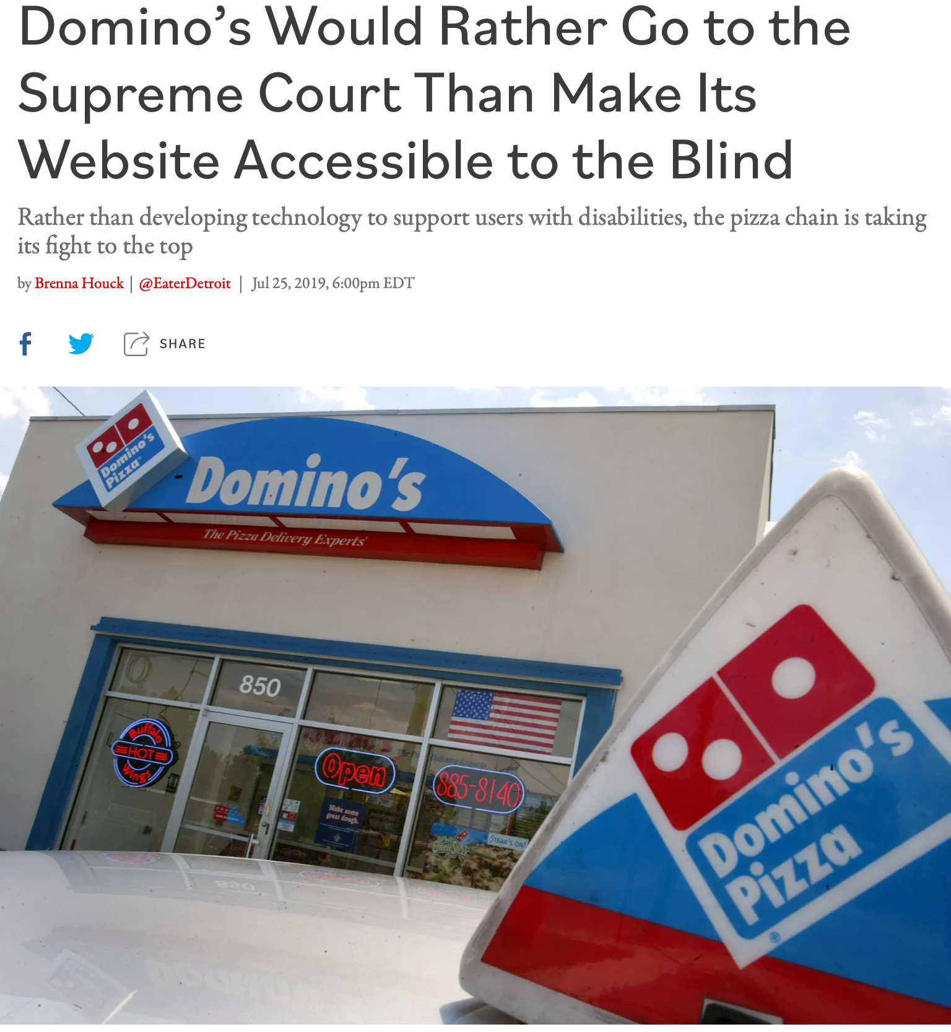
Poor user interfaces can discriminate against differently-abled people.
Inclusivity and Accessibility: Domino’s Pizza LLC v. Robles
“Domino’s Would Rather Go to the Supreme Court Than Make Its Website Accessible to the Blind” by Brenna Houck, Eater Detroit
Notes:
There are also very direct ways that we can inadvertently construct software that is not inclusive of all of our users. For instance: is our software accessible to users who have disabilities, such as being blind or low-vision? The Americans with Disabilities Act requires that public places must be accessible to people with disabilities. In 2019 a blind man sued Domino’s for not providing an interface for ordering pizza that was compatible with screen-readers, which is a kind of technology that is key to making computer accessible to the blind.
Dominos argued that the ADA only applies to physical interactions, since it was written before Internet, so how are we supposed to know what an accessible website is? The question brought before the supreme court, was, basically: do online retailers need to provide an accessible website? Many within the retail and restaurant industries filed amicus briefs backing Domino’s, stressing the “impossibility of guessing what accessibility means in the online environment.” The supreme court found that the ADA applies to websites, too. We’ll come back to this example in our next lesson.
http://jlsp.law.columbia.edu/2020/02/13/inaccessible-pizza-delivery-and-the-future-of-the-ada/

Slide 9
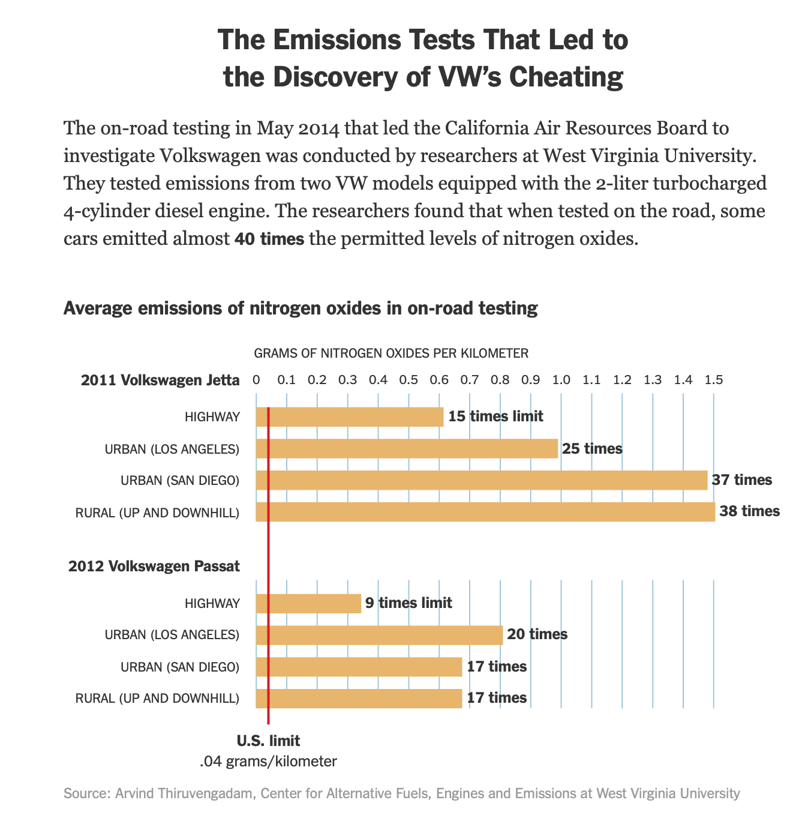
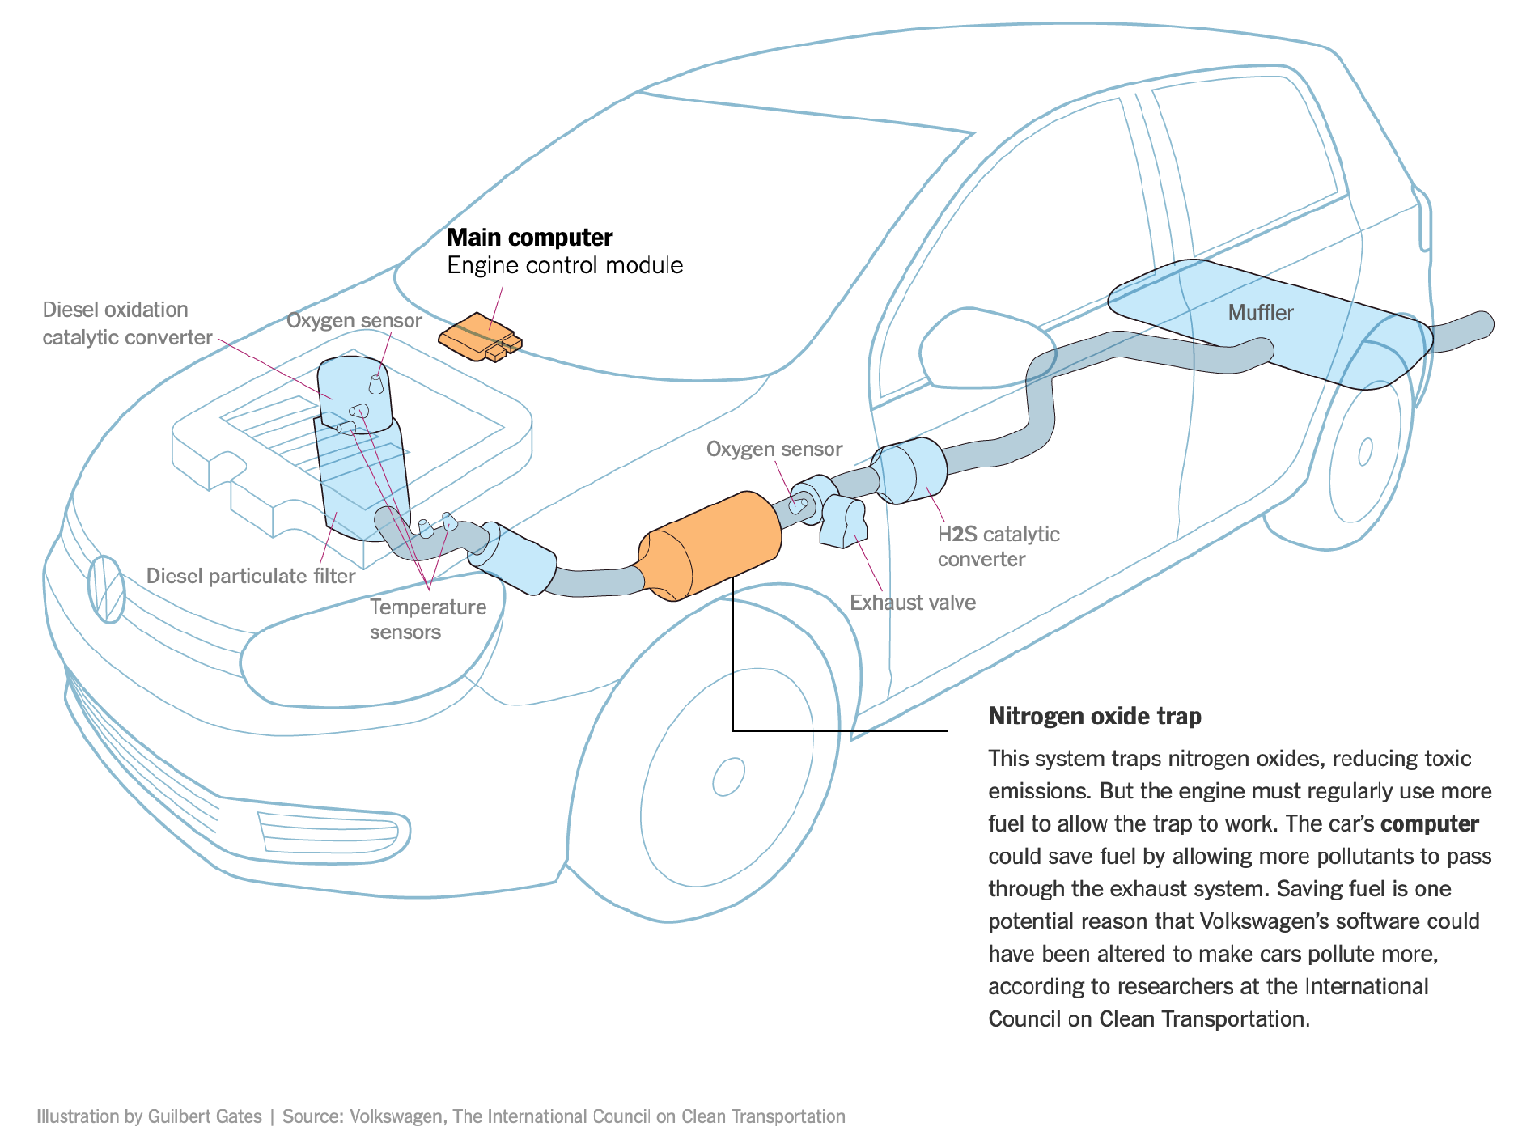
Software Systems can be used to evade regulation.
Example: Volkswagen diesel emissions
$14.7 billion settlement
“How Volkswagen’s ‘Defeat Devices’ Worked” By Guilbert Gates, Jack Ewing, Karl Russell and Derek Watkins
Notes:
It’s hard to talk about engineering equitable software and not bring up the Volkswagen emissions testing defeat device. If you’re not familiar with this scandal: cars are held to a particular emissions standard. Particularly in diesel cars, reducing emissions often tracks with reducing performance. Again, the question of “how much emissions are too much, if any” is out of scope for this discussion, and instead, we’re focusing on the regulations that existed at the time of this scandal. Cars are tested for this emissions standard in off-road simulators, where they can be easily hooked up to equipment that directly measures their emissions. Volkswagen’s engine control unit had customized software to detect when the car was under an emissions test and tune the engine to reduce performance and emissions, resulting in emissions tests that significantly under-represented the actual emissions of the vehicle. (Click) This software mislead regulators and consumers, and ultimately Volkswagen agreed to spend $14.7 billion in a settlement, and was subject to significant public relations damage.

Slide 10
Software can be used in unanticipated ways
Good twitter:
Keeping people informed,
Organizing
Helping people find communities
“Verified identities”
Bad twitter:
Spreading misinformation
Bullying
Intimidation
“Identities for sale, $7/month”

Slide 11
Inequities can arise in many ways
Intentional (like VW)
Unintentional bias on the part of the designer (like “sex: male or female”
Engineering shortcuts (like Domino’s)
Unanticipated changes in usage or society (like Twitter)

Slide 12
Engineering Equitable Software Requires Conscious Effort
Not just “don’t be evil”
How do we determine what “the right thing” is?
How do we convince our investors/managers to take this action?
Notes:
Engineering equitable software requires conscious effort. It is not simple enough to take on a motto like “don’t be evil” or “do the right thing,” when it is often difficult to fully comprehend the societal impacts of our technical decisions. Moreover, even when we do see a clear potential harm to some portion of the population, taking corrective action can be challenging.

Slide 13
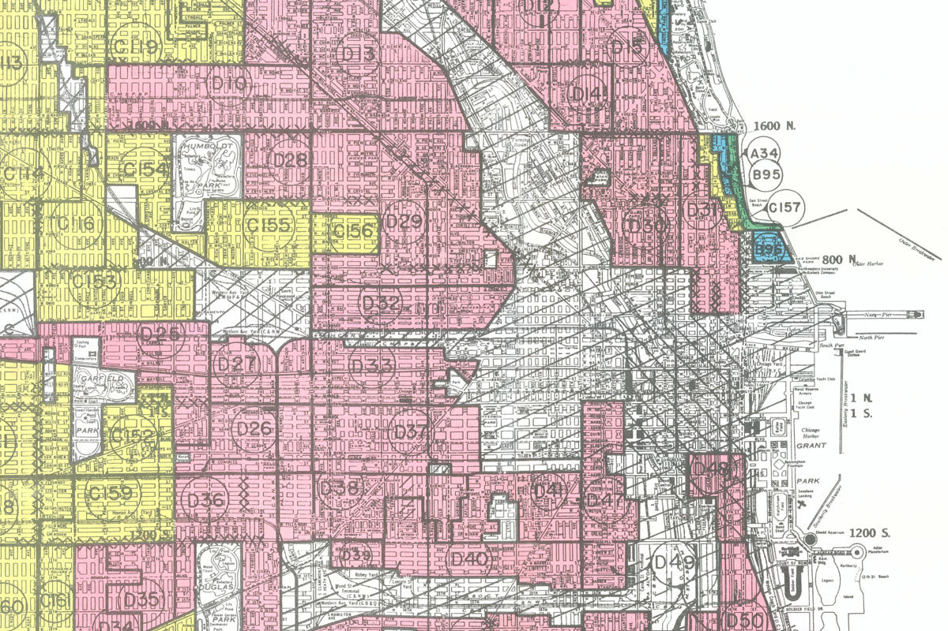
Every design decision advantages some and disadvantages others
Prioritize short print jobs over long ones?
Prioritize high-value customers in phone queues?
Whose interests to prioritize in recommendation systems?
The people doing the searching?
The people who have materials that they want found?
The people running the recommendation system?
Prioritize people who are “good risks”
Red-lining
Felt pads
Notes:
Red-lining was the policy of marking certain neighborhoods as “high-risk” areas. The effect was that banks would not lend to you if you lived in those areas. So you were permanently disadvantaged if you lived there: you couldn’t get a mortgage; you couldn’t get a loan to start a business, etc. This led to racial segregation and social unrest. Redlining was outlawed in 1968, but its effects still linger.
On a much smaller scale, I am told that American Express discovered that if you used felt pads on the bottoms of your chairs, you were more likely to pay your bills on time. I don’t know if this story is true, but if it were, would it be justified as a basis for making a credit decision?

Slide 14
There are often conflicting values that must be reconciled
What would you generate as an alt-text for this image?
A Native American man on a horse and a white woman on a horse?
A man on a horse and a woman on a horse?
One alternative reinforces racial stereotypes; the other denies the man his identity.
Notes:
Here’s another example I learned about recently. Automated alt-text systems intersect with a wide variety of social issues. The words you use can often offend people. Sometimes people will be offended no matter what words you choose. If computers generate text for captions and the like, how do you reconcile these conflicting values.

Slide 15
How should we go about analyzing our software for equity?
Notes:
Given all those potentials for harm, how can we make progress? How do we start analyzing a piece of software for its potential harms and benefits?

Slide 16
How can my software make a positive contribution?
Can my software make people’s jobs easier?
Can my software make people happier?
Can my software amplify positive behavior for users and society at large?
How can my software better achieve these goals?
Notes:
Similarly, when we are trying to become excited about some software project and its potential for good, we might think about the potential for our software to make people’s jobs easier and make people happier, broadly amplifying positive behavior for our users and the general public.
If we identify these goals, we can evaluate them as part of our software quality process

Slide 17
How can my software cause harm?
Who will be advantaged by the use of my software, and who be disadvantaged?
How can my software fail? What are the implications of that failure?
Who will use my software, and how might different users use it differently?
How will my software impact those who do not use it directly?
Notes:
So, when considering that we want to do no harm to the public interest, we might consider asking ourselves questions like this:
If there’s a bug in my software, what could be the resulting impact? What parts of my software will be most likely to have negative human impacts if buggy, and how do we test that part most effectively?
Who will be the users of my software, and will it impact different users in different ways? Will my software disadvantage some users?
Will there be a negative impact on people who do NOT use my software, for instance through climate, or through social forces?

Slide 18
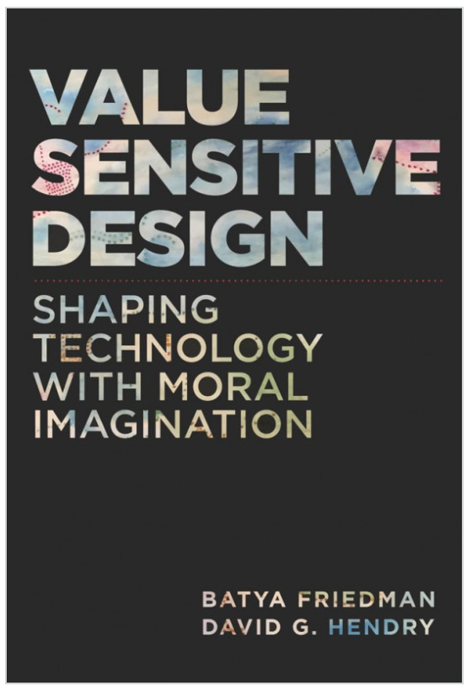
What values might our software promote or diminish?
Human rights - Inalienable, fundamental rights to which all people are entitled
Accessibility - Making all people successful users of the technology
Justice - Procedural justice (process is fair) + distributive justice (outcomes are fair)
Privacy - An individual’s agency in determining what information about them is shared
Human welfare - Physical, material and psychological well-being
Value Sensitive Design @ Khoury
Notes:
Value-sensitive design is an approach to guide the design of technology while considering the impact of the technology on a variety of core human values. This approach can help us to identify unintended consequences of our software, which we can then begin to reason about.
Core values include human rights, accessibility, justice, privacy and human welfare, and many others.
As we think about the software that we’re building, we can ask ourselves explicitly: how does our software impact these values?

Slide 19
Code of Ethics
ACM’s Code of Ethics Software Engineers
1. PUBLIC – Software engineers shall act consistently with the public interest.
2. CLIENT AND EMPLOYER – Software engineers shall act in a manner that is in the best interests of their client and employer consistent with the public interest.
3. PRODUCT – Software engineers shall ensure that their products and related modifications meet the highest professional standards possible.
4. JUDGMENT – Software engineers shall maintain integrity and independence in their professional judgment.
5. MANAGEMENT – Software engineering managers and leaders shall subscribe to and promote an ethical approach to the management of software development and maintenance.
6. PROFESSION – Software engineers shall advance the integrity and reputation of the profession consistent with the public interest.
7. COLLEAGUES – Software engineers shall be fair to and supportive of their colleagues.
8. SELF – Software engineers shall participate in lifelong learning regarding the practice of their profession and shall promote an ethical approach to the practice of the profession.
1. PUBLIC – Software engineers shall act consistently with the public interest.
https://ethics.acm.org/code-of-ethics/software-engineering-code/
Notes:
Software Engineers are not legally held to any code of ethics, and unlike many other professionals (like lawyers, doctors, and civil engineers), we are not licensed by a professional society who holds us to ethical standards. Nonetheless, the ACM, one of the largest professional societies for computer scientists, has established a code of ethics for software engineers. This code is quite similar to those for professional engineers, and includes as the first tenet, (click) that software engineers should act consistently with the public interest - both doing no harm to the public, and hopefully doing good.

Slide 20
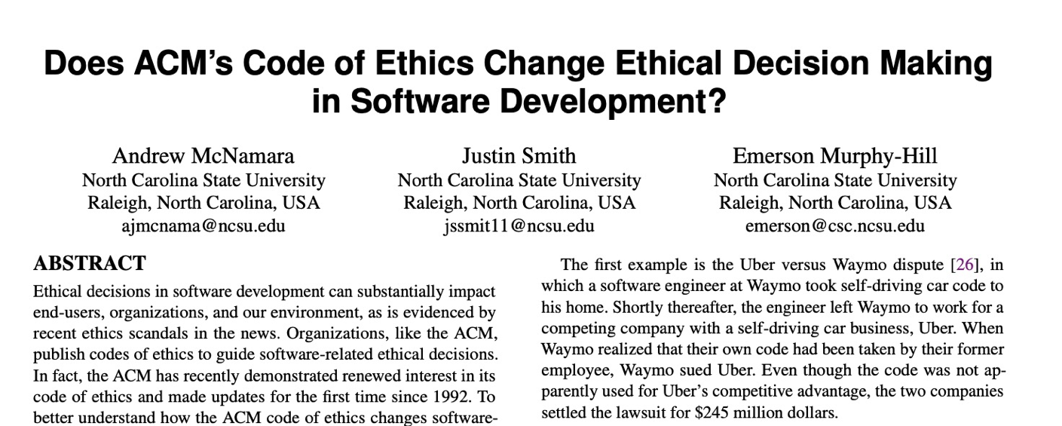
Code of Ethics
ACM’s Code of Ethics Software Engineers
TLDR: No
1. PUBLIC – Software engineers shall act consistently with the public interest.
2. CLIENT AND EMPLOYER – Software engineers shall act in a manner that is in the best interests of their client and employer consistent with the public interest.
3. PRODUCT – Software engineers shall ensure that their products and related modifications meet the highest professional standards possible.
4. JUDGMENT – Software engineers shall maintain integrity and independence in their professional judgment.
5. MANAGEMENT – Software engineering managers and leaders shall subscribe to and promote an ethical approach to the management of software development and maintenance.
6. PROFESSION – Software engineers shall advance the integrity and reputation of the profession consistent with the public interest.
7. COLLEAGUES – Software engineers shall be fair to and supportive of their colleagues.
8. SELF – Software engineers shall participate in lifelong learning regarding the practice of their profession and shall promote an ethical approach to the practice of the profession.
1. PUBLIC – Software engineers shall act consistently with the public interest.
https://ethics.acm.org/code-of-ethics/software-engineering-code/
Notes:
Studies have investigated whether simply exposing engineers to this code of ethics improves ethical decision making in software development
(Click)
(click),
concluding that this code alone does not improve ethical decision making.
Ethical decisions often involve weighing multiple trade-offs: in the case of the Citigroup tower, the engineering firm (and their client, and their insurer) had to make a difficult ethical choice: should they immediately publicly disclose the fact that a strong wind could topple the tower - clearly a concern in the public interest, or should they instead prepare with officials to perform an emergency evacuation and monitor the weather closely without informing the public about the potential hazard (which could provoke unnecessary panic)? A code of ethics alone does not give sufficient guidance.

Slide 21
Standards can give more concrete guidance.
International bodies define standard processes that are designed to protect the public
By (correctly) following such a standard, you can reduce the chance of harm to users, as well as your ethical (and legal) liability
Notes:
Areas where there are well-defined standards give the engineer more concrete guidance. For example, companies constructing medical device software must now comply with well-defined standard processes for developing that software in a way that will assure safety. Simply following the standard doesn’t guarantee safety, but doing so can help to ensure that it does, while also reducing our legal and moral liabilities.

Slide 22
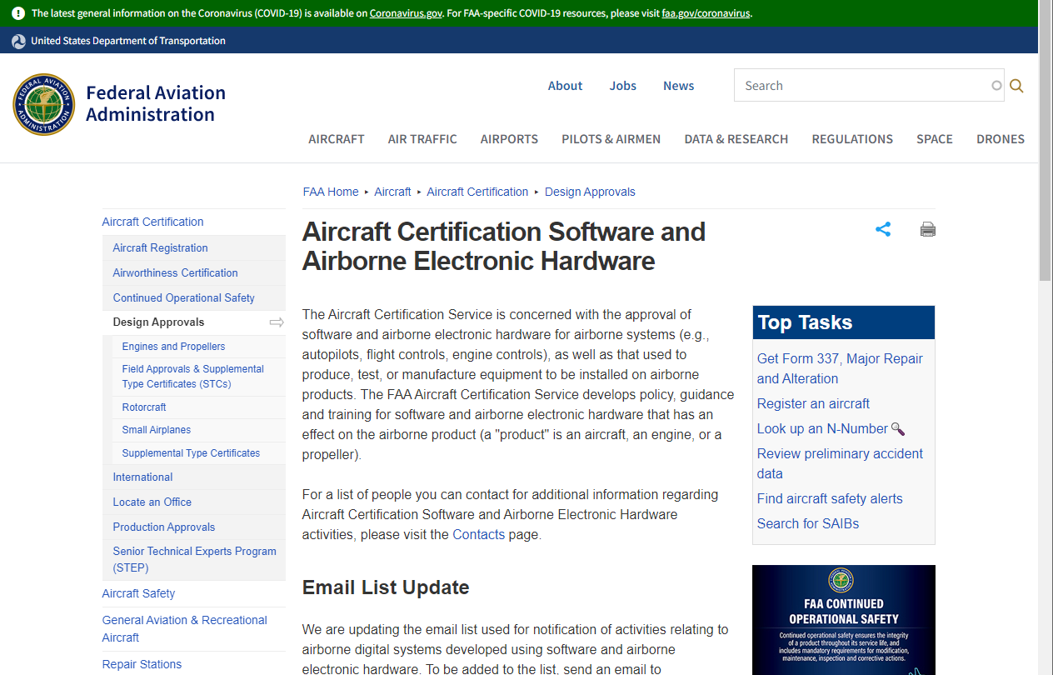
Standards can give more concrete guidance.
Notes:
Similarly, aircraft software must follow a rigorous certification process.

Slide 23
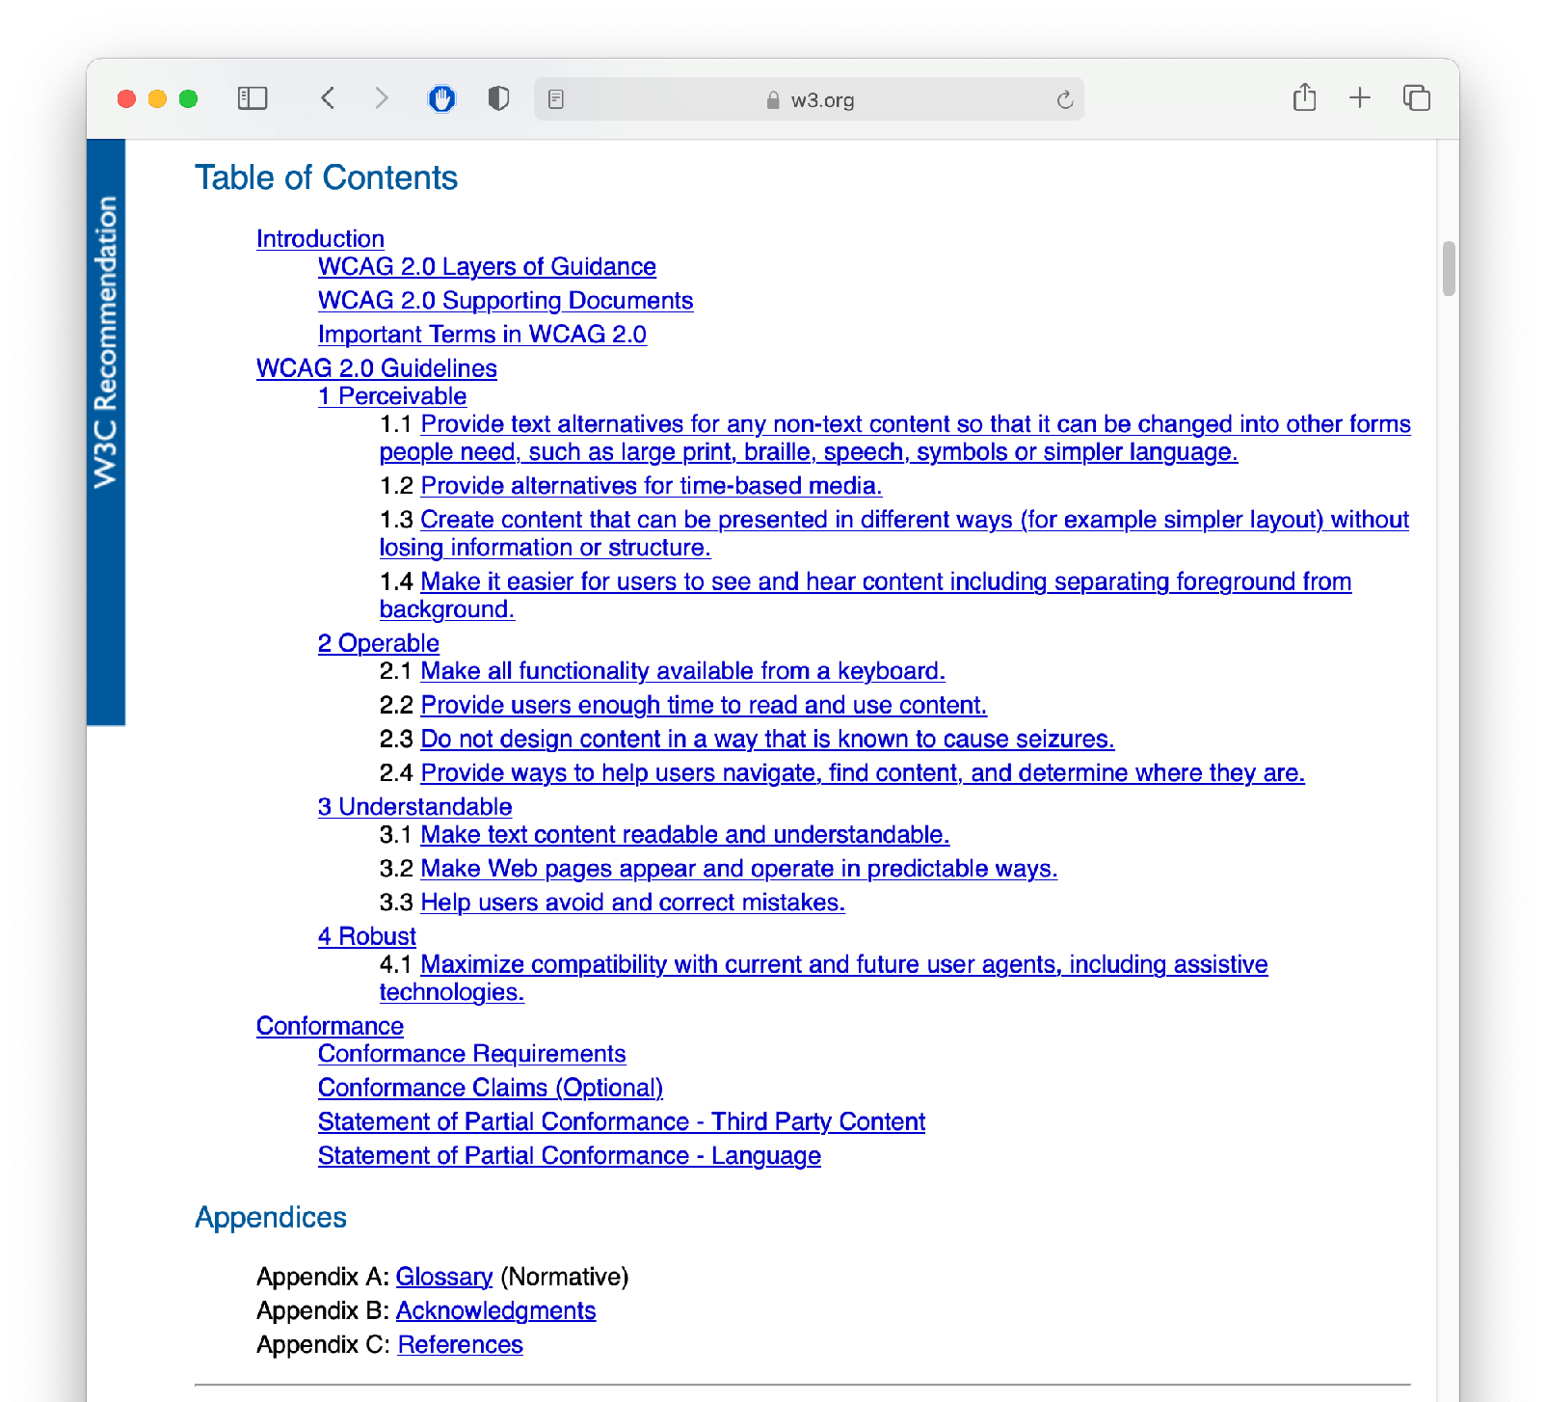
Standards can give more concrete guidance.
Example: Domino’s + ADA
WCAG 2.0 Spe
cification
Notes:
For example, in the case of Domino’s unwillingness to comply with the ADA, there was a standard that could have been followed: the Web Content Accessibility Guidelines (WCAG), which date from 2008– over a decade before the suit.
In court documents, Domino’s revealed it would have cost just $38,000 to resolve the raised accessibility issue

Slide 24
What actions can we take?
How can we anticipate the harms our software might do?
How do we design our software to mitigate unintentional harms?
How do we work with our teams and employers to minimize the harms that our software might do?
Everything can and should be iterated on, including the problem itself … what are we trying to solve?​

Slide 25
Inclusiveness and Iteration are key
For every piece of software you create, you should iterate on it and include a wide range of people to use your software.
By including more people you can better detect biases and harm that your software might create on certain populations.

Slide 26
Guidelines from Microsoft on how to create software for people that mitigates harm.
Link: https://www.microsoft.com/en-us/research/uploads/prod/2020/03/Guidelines_summary_image@2x.png

Slide 27
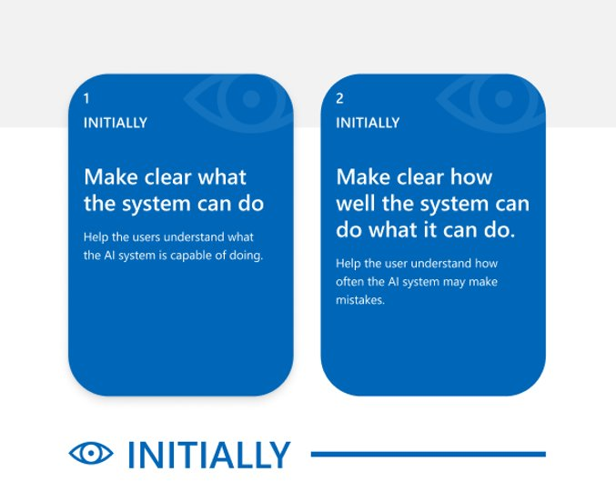

Slide 29
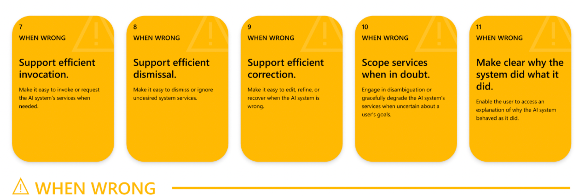

Slide 30
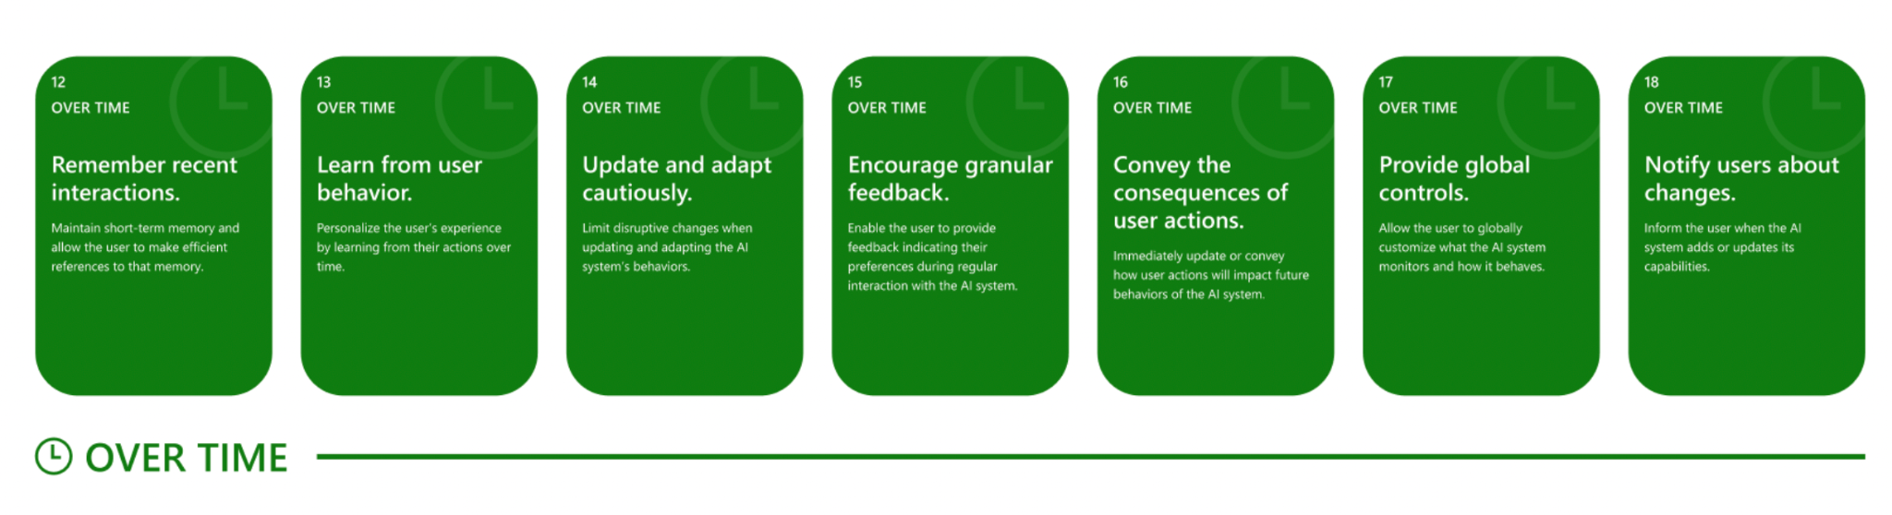

Slide 31
Where does this leave us?
So that we can sleep at night
Consider the different ways that our software may impact others
Consider the ways in which our software interacts with the political, social, and economic systems in which we and our users live
Follow best practices, and actively push to improve them
Encourage diversity in our development teams
Engage in honest conversations with our co-workers and supervisors to explore possible ethical issues and their implications.
Notes:
There’s no silver bullet for ethical software development. However, hopefully now you understand better the different ways that our software can have impacts on others, and how we can reason about those implications.

Slide 32
This lesson was about the harms that software can inflict
You should now be able to…
Suggest some ways in which software can cause inadvertent harm or amplify inequities, with examples
Explain why the software engineer has a powerful role to play in avoiding such harms.

Slide 33
Learning Objectives for this Lesson
You should now be able to:
List some ways in which software can cause inadvertent harm or amplify inequities, with examples
Explain some techniques that a software engineer can use to detect and mitigate these harms.

Slide 34
Learning Objectives for this Lesson
You should now be able to:
Explain several of the meanings of “the public interest”.
List some sources of ethical guidance for a software engineer.
List several things that a software engineer can do to try to behave in an ethical manner.

